Slide 1

外贸函电
尚德机构
SUNLAND
嘉嘉老师

Slide 2
Lesson 4 Offers
报盘

Slide 3
报盘 Offers
★报盘是商业交易中买卖双方必经的过程。
★ 一方向另一方提出某种交易条件（如： 商品名称、数量、规格、交货期及付款条件等）
★卖方Offer, Selling Offer, Offer to Sell;
买方Offer, Buying Offer, Offer to Buy或bid

Slide 4
报盘 Offers
报盘分为实盘和虚盘。
☆实盘（Firm Offer）: “不可撤销的发盘”
发盘人问受盘人提出完成、明确、肯定的交易条件，并愿在一定时间内达成交易。
☆虚盘（Non-firm Offer）: 卖方所作的非承诺性表示，并附保留条件，买方接收后卖方仍可以改变主意。

Slide 5
报盘 Offers
报盘属于中性信息，布局采用平铺直叙法

Slide 6
报盘的布局采用_______?

Slide 7
报盘采用平铺直叙法

Slide 8
例1： 实盘（Firm Offer）
Dear Mr. Ali:
Thank you for your letter of April 8, inquiring about our lithium rechargeable batteries for mobile phones. We are glad to offer you 5000 pieces lithium rechargeable batteries, style No.MTA190 at US $3.40 per piece FOB China. Shipment will be effected within 20 days after receipt of the relevant sight L/C in our favor issued by a bank acceptable to us.
This offer is valid for 10 days.
……
Sincerely,

Slide 9
例2： 虚盘（Non-firm Offer）
Dear Jones,
We offer 300 metric tons of polished long grain rice, 2005 crop, 15% broken, at USD220 per metric ton FOB Huangpu, for shipment during October/November 2005. Payment is to be effected by irrevocable sight L/C.
This offer is subject to goods being unsold.
…...
Yours truly,

Slide 10
虚盘（Non-firm Offer）：
不规定报盘的有效日期；
并附有保留条件或无约束力的词语

Slide 11
如： The offer is subject to our final confirmation/ prior sale.
无约束力的词语或附有保留条件

Slide 12
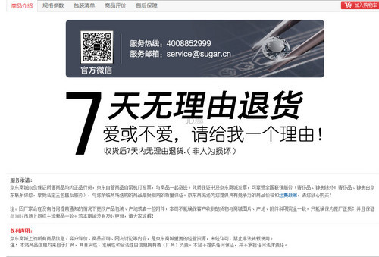

实盘VS虚盘
实盘
虚盘

Slide 13
实盘（Firm Offer）的特征：
irrevocable adj. 不可撤销的
valid adj. 有效的

Slide 14
虚盘（Non-firm Offer）的特征：
subject to …. 以…为条件（为准）

Slide 15
必备短语
lithium rechargeable battery 可充电锂电池
mobile phone 移动电话
in our favor 以我方为受益人
please refer to the catalog enclosed for complete list of models available now.
关于现在可供型号的全部清单， 请参见附件中的目录本。

Slide 16
必备短语
5. introductory price 介绍期价格
6. attention n. 办理 （attend的名词）
7. metric ton 公吨
8. 2005 crop 2005年产
9. broken 碎（米）
10. advancing n. （行市）坚挺
11. competitive price 有竞争力的价格

Slide 17
必备短语
12. to withdraw an offer 撤回报盘
13. to decline an offer 谢绝报盘
14. subject to 以…为条件（为准）。
15. subject to our final confirmation 以我方最后确认为准
16. offer subject to our written acceptance 以我方书面接受为准的报盘
17. offer 报盘（货名、规格、数量、价格、船期等）

Slide 18
Use Common Words
用简洁平常的词汇书写商务信函

Slide 19
对比一下
approximately
initiate
duplicate
accomplish
terminate
equivalent

Slide 20
对比一下
approximately
initiate
duplicate
accomplish
terminate
equivalent
about
begin
copy
do
end
equal

Slide 21
宜： 简洁 简短 简明
忌： 复杂 繁杂 冗长

Slide 22
最简单的我的帮你整理好了：
about 关于
begin 开始
build 建立
copy 拷贝 备份
decide 决定
do 做，完成
end 结束
equal 平等的
9. find out 找出
10. give 给
11. harmful 有害的
12. height 高度
13. much 很多
14. shorten 缩短
15. show 展示
16. stop 停止

Slide 23
最简单的我的帮你整理好了：
17. try 尝试
18. use 使用
19. useless 无用的，没用的
20. vague 不清楚的，不明确的

Slide 24
练习题： 中译英
如你方以竞争性价格报盘，我们能保证在当地大量销售。
作为对你们还价的回应，我将降价3美元。
考虑到我们的长期业务关系，我们接受你们的还盘。
希望早日报给我们机床的实盘，我们将不胜感激。
我的报价是以合理利润率为依据。
现在我们希望你们对我方报盘予以答复。

Slide 25
练习题： 中译英
如你方以竞争性价格报盘，我们能保证在当地大量销售。
If you make an offer at competitive prices we can sell a large quantity in our district.
2.作为对你们还价的回应，我将降价3美元。
I’ll respond to your counter-offer by reducing our price by three dollars.

Slide 26
练习题： 中译英
3.考虑到我们的长期业务关系，我们接受你们的还盘。
It is in view of our long-standing business relationship that we accept your counter offer.
4.希望早日报给我们机床的实盘，我们将不胜感激。
It will be appreciated if you will immediately let us have your firm offer for machine tools.

Slide 27
练习题： 英译中
5.我的报价是以合理利润率为依据。
My offer was based on reasonable profit margin.
6.现在我们希望你们对我方报盘予以答复。
Now we look forward to your replying to our offer.

Slide 28
练习题： 英译中
Thank you for your interest in our products. We are now sending you our latest catalog and price list by courier service.
They are not interested in small quantities.
We are now interested in purchasing substantial quantity of polyester cotton blended fabrics of the following specifications. Please quote your rock bottom prices.
We are now in need of the following specialties of your corporation.

Slide 29
练习题： 中译英
5. We have recently extended our radio and television department and are now thinking of adding new ranges to our present stocks. We are particularly interested in your “Panda” radio and “Rainbow” television receivers. Please send us your firm offer.
6. We will let you know which item(s) we are interested in as soon as we receive the reference materials.

Slide 30
练习题： 中译英
Thank you for your interest in our products. We are now sending you our latest catalog and price list by courier service.
感谢你们对我方产品的兴趣，现以特快邮递寄去最新的商品目录和价目表。

Slide 31
练习题： 中译英
2. They are not interested in small quantities.
他们对小数量不感兴趣。
We are now interested in purchasing substantial quantity of polyester cotton blended fabrics of the following specifications. Please quote your rock bottom prices.
本公司有意购买一下规格的混纺人造纤维， 请贵公司提出最低价格。

Slide 32
练习题： 中译英
We are now in need of the following specialties of your corporation.
我们现在需要贵公司以下特色产品。
5. We have recently extended our radio and television department and are now thinking of adding new ranges to our present stocks. We are particularly interested in your “Panda” radio and “Rainbow” television receivers. Please send us your firm offer.
本公司新近扩大了收音机和电视机销售部门，如今有意将日前的货色，增加新式样。对于贵公司的“熊猫牌”收音机和“长虹牌” 电视机，本店极为感兴趣，请报实盘。

Slide 33
练习题： 中译英
6. We will let you know which item(s) we are interested in as soon as we receive the reference materials.
当我们受到参考资料，便即刻通知贵公司我们所感兴趣的货项。

Slide 34
复杂/ 冗长的词会出现在英译中句子中，
所以还是要记住！！！

Slide 35
练一练： 写出下列词汇相对应的简短的词汇
1. ascertain
2. commence
3. considerable
4. interrupt
5. minimal
6. modification
7. proceed
8. supersede
9. ultimate
10. verification

Slide 36
写出下列词汇相对应的简短的词汇
1. ascertain
2. commence
3. considerable
4. interrupt
5. minimal
find out
begin
much
hinder
smallest

Slide 37
写出下列词汇相对应的简短的词汇
6. modification
7. proceed
8. supersede
9. ultimate
10. verification
6. change
7. go
8. replace
9. last
10. proof

Slide 38
练一练： 把下列简洁词汇和复杂词汇配对
smallest
go
replace
proof
last
find out
begin
much
proceed
minimal
supersede
commence
ascertain
ultimate
considerable
verification

Slide 39
练一练： 把下列简洁词汇和复杂词汇配对
smallest
go
replace
proof
last
find out
begin
much
proceed
minimal
supersede
commence
ascertain
ultimate
considerable
verification

Slide 40
Lesson 5 Proforma Invoices
形式发票

Slide 41
Proforma Invoices 形式发票
★ 也称预开发票或估价发票。
★ 进口商为向本国当局申请进口许可证或请求核批外汇拟将出售成交的商品名称、单价、规格等条件开立一份参考发票，内容格式与商业发票基本相同。
★ 形式发票可当做报价单，寄送形式发票相当于报价。

Slide 42
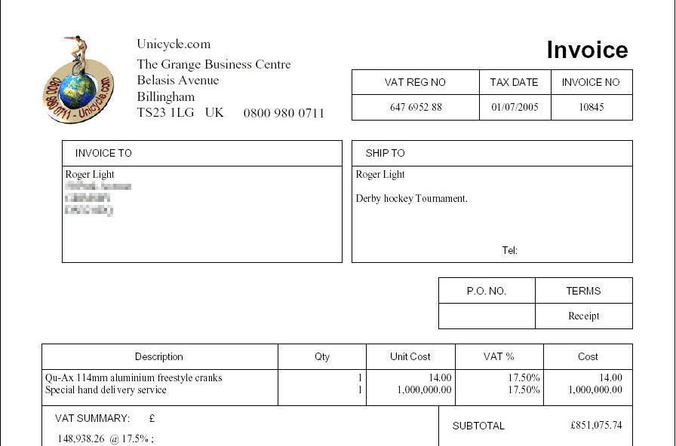

Slide 43
例 1： 顾客要求开出形式发票
Dear Sirs,
Re: Proforma Invoice
Will you please send us the soonest possible your profoma invoice for 1000 pieces sewing machines with prices CIF Lagos? Our client in Lagos, Nigeria, requests us to obtain from you a quotation for sewing machines with the following specifications:
“Butterfly” brand, treadle type,
Three drawers and five drawers (each 500 pieces)
…… We shall establish an L/C in your favor.
Yours faithfully,

Slide 44
例2： 回复顾客要求
Gentlemen:
Thank you for your letter of October 27, we are sending you the required proforma invoice in triplicate. Please note that our offer remains valid until November 15,…
…..
Our sewing machines are selling fast, and there have been numerous enquiries about them. Please take the necessary steps without delay.
Yours truly,

Slide 45
Word Bank:
proforma adj. 形式的
invoice n. 发票
treadle n. 踏板
drawer n. 抽屉
license n. 许可证
authorities n. 当局，官方
triplicate n. 一式三份
valid adj. 有效的（合约，硬盘等）
numerous adj. 许许多多

Slide 46
黄金句型：
There is no question about getting the necessary import license from our authorities.
authorities复数作“当局”
2. The goods are selling fast.
这货销得很快。
（一般现在时或现在进行时）

Slide 47
黄金句型：
3. Please take the necessary steps.
请采取必要的步骤。
（等同于“Please do the necessary”）

Slide 48
Avoid Biased Words
避免歧视词汇

Slide 49
性别歧视词汇
★ 英语有用男性代词表示男女统称。
he/ him/ his
☆ 解决办法： 改代词的单数为复数
用she/he her/him her/him
把两个性别都写出来。

Slide 50
性别歧视词汇
★ 以“man” 为词根组合或派生出来的词汇。
如： chairman /policeman/ salesman
☆ 解决办法： 如需表示女性，改man为woman
businessman(男)– businesswoman (女)
chairman(男)– chairwoman (女)
salesman (男)– saleswoman(女)

Slide 51
练一练： 写出对应男性词汇的女性词汇
chairman
businessman
him
his
he
salesman

Slide 52
练一练： 写出对应男性词汇的女性词汇
chairman
businessman
him
his
he
salesman
chairwoman
businesswoman
her
her
she
saleswoman

Slide 53
练习题： 中译英
此报盘着眼于扩大销路而且很有竞争性。
该报盘以你方本月底前到达我地位有效。
我们高兴地告知你们，我们可以为新订单提供特别的设计方案。
除非你们降价5%，否则我们无法接受报盘。
我们以按年方要求将报盘延期。
我们的还价是每公吨伦敦离岸价150美元。

Slide 54
练习题： 中译英
1.此报盘着眼于扩大销路而且很有竞争性。
This offer is based on an expanding market and is competitive.
2.该报盘以你方本月底前到达我地位有效。
This offer is subject to your reply reaching here before the end of this month.

Slide 55
练习题： 中译英
3. 我们高兴地告知你们，我们可以为新订单提供特别的设计方案。
We are pleased to advise you that we are able to offer a special designing plan for the modification of your new order.
4. 除非你们降价5%，否则我们无法接受报盘。
We can’t accept your offer unless the price is reduced by 5%.

Slide 56
练习题： 中译英
5. 我们以按年方要求将报盘延期。
We have extended the offer as per as your request.
6. 我们的还价是每公吨伦敦离岸价150美元。
We make a counter-offer to you of 150$ per metric ton FOB London.

Slide 57
练习题： 英译中
Since the prices of the raw materials have been raised, I’m afraid that we have to adjust the prices of our products accordingly.
To conclude this business, you need t lower your price at least by 31%.
We find it difficult to fill your order at the prices indicated in your letter because of the high cost of raw materials.
You said yesterday that the price was $60/mt, CIF Brusels.

Slide 58
练习题： 英译中
5. Your price is $500/mt, twice of the other countries.
6. We can safely say for sure that our prices are quite realistic. Other suppliers can not possibly under-quote us if their goods are as good as ours in quality.

Slide 59
练习题： 英译中
Since the prices of the raw materials have been raised, I’m afraid that we have to adjust the prices of our products accordingly.
由于原材料价格上涨，我们恐怕不得不对产品的价格做相应的调整。

Slide 60
练习题： 英译中
2. To conclude this business, you need t lower your price at least by 31%.
为达到这笔交易，你方应至少减价3%。

Slide 61
练习题： 英译中
3. We find it difficult to fill your order at the prices indicated in your letter because of the high cost of raw materials.
由于原材料的成本高昂，我们难以按照你方来信所使价格满足订货。

Slide 62
练习题： 英译中
4. You said yesterday that the price was $60/mt, CIF Brusels.
您昨天说价格是每公吨60美元布鲁塞尔到岸价。

Slide 63
练习题： 英译中
5. Your price is $500/mt, twice of the other countries.
你们的价格是每公吨500美元，为其他国家的两倍。

Slide 64
练习题： 英译中
6. We can safely say for sure that our prices are quite realistic. Other suppliers can not possibly under-quote us if their goods are as good as ours in quality.
可以肯定地说我方价格是相当合理的，质量与我方产品相同的供货商不可能报比我方低的价格。

Slide 65
Lesson 6 Terms and Conditions
合同条款

Slide 66
合同或协议一般包含两个部分：
◆ 专用条款（specific terms and conditions）
◆ 通用条款（general terms and conditions, 也成为一般条款）

Slide 67
通用条款（general terms and conditions）:
★ 重要性大于专用条款
★作为附件寄给客户
★内容固定
★一般称为： Cover Letter

Slide 68
专用条款（specific terms and conditions）:
★特定的合同特有的条款
★包含商品规格、名称、数量、单价、价格条款、总金额、交货期、装运港等。

Slide 69

专用条款

Slide 70
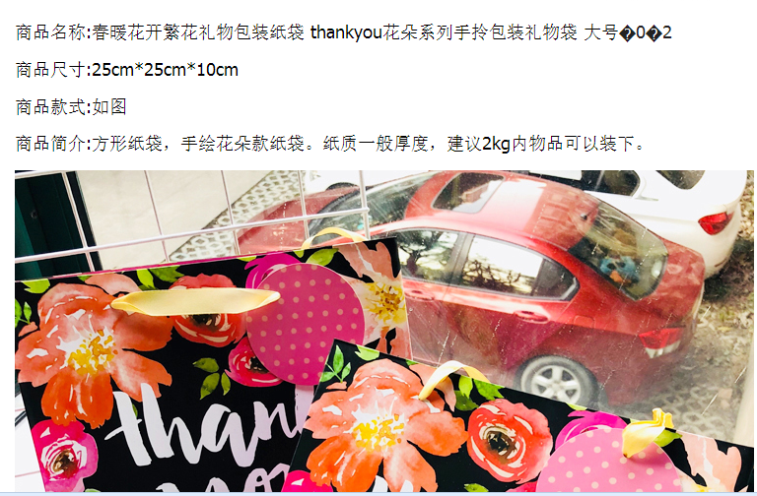
专用条款

Slide 71
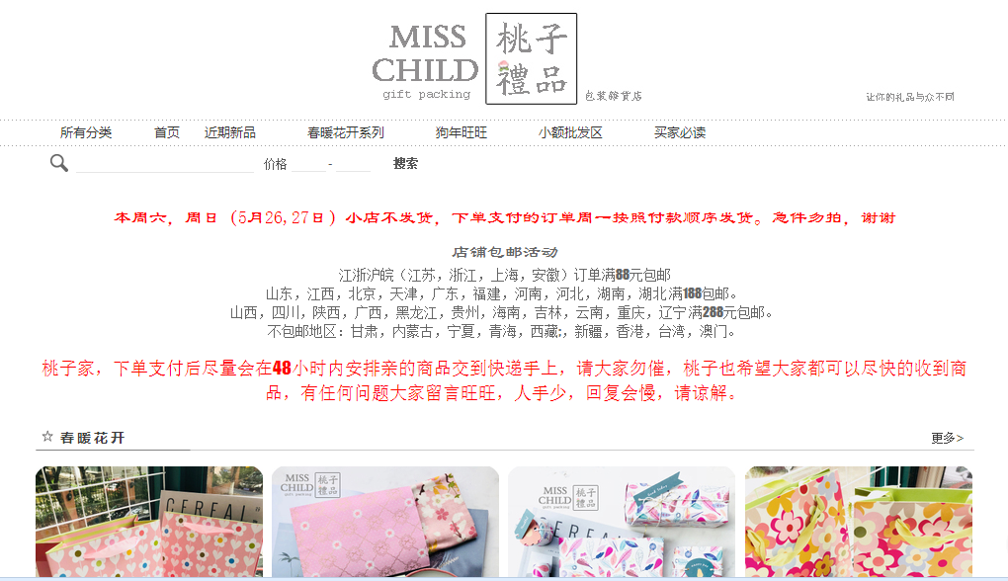
通用条款

Slide 72
例： Cover Letter
Dear Sirs,
Enclosed is our general terms and conditions for our international trade. As you can see, it is adapted from the model contract for the International Sale of Goods.
……
… because the Specific Conditions supersede the General Conditions.
Yours truly,

Slide 73
Word Bank:
adapt v. 改写，改变
supercede v. 取代
Any terms we agree to differ from these conditions can be stipulated in the Specific Conditions without amendment to the General Conditions because the Specific Conditions supercede the General Conditons.
我们达成的协议如果不同于一般条款，可以在特别条款中列明，无须更改一般条款，因为特别条款的效力优先于一般条款。

Slide 74
General Conditions
Art.1 General (Art.= Article 条款)
总则
Art.2 Characteristics of the goods
货物的特征
Art.3 Inspection of the goods before shipment
货物装运前的检验
Art.4 Price
价格
Art.5 Payment
支付条件

Slide 75
General Conditions
Art.6 Interest in case of delayed payment
延迟付款时的利息
Art.7 Retention of title
货物所有权的保留
Art.8 Contractual term of delivery
合同的交货贸易术语
Art.9 Document
单证（单据和凭证）
Art.10 Late-delivery, non-delivery an remedies therefor
延迟交货、不交货及其补偿

Slide 76
General Conditions
Art.11 Non-conformity of the goods
货物不符约定
Art.12 Cooperation between the parties
双方的合作
Art.13 Force majeure
不可抗力
Art.14 Resolution of disputes
争议的解决

Slide 77
合同中用词的特点：
使用正式用语（formal terms）

Slide 78
举个栗子
因为： by virtue of ---- due to / because of
财务年度末： at the close of the fiscal year– in the end of the fiscal year
在…之前： prior to ---- before
关于： as regards/ concerning/ relating to ---- about

Slide 79
合同中喜欢用虚词
Hereinafter referred to as / whereas/ in witness whereof / for and on behalf of / hereby/ thereof/ hereto 等虚词
英语合同中的一大特色

Slide 80
合同条款翻译练习
Put the following sentences into English:
现随函附上我方的销货合同第HN768号一式两份，请查收。如审查无误，请会签后回退1份。
经过长时间断断续续的谈判，我们现在终于达成了协议。
我们销售产品是以货样为标准，而不是凭多去任何一批供货的质量。
我认为这不会有问题，生产部门会有办法。

Slide 81
合同条款翻译练习
1.现随函附上我方的销货合同第HN768号一式两份，请查收。如审查无误，请会签后回退1份。
Enclosed is our Sales Contract No. HN768 in duplicate. If you find everything in order, please sign and return one copy.
2.经过长时间断断续续的谈判，我们现在终于达成了协议。
Through lengthy and on-and-off negotiations we now finally have reached an agreement.

Slide 82
合同条款翻译练习
3.我们销售产品是以货样为标准，而不是凭多去任何一批供货的质量。
We sell goods according to the sales sample, not the quality of any previous supplies.
4.我认为这不会有问题，生产部门会有办法。
I don’t think that would be a problem. The production department will come up with something.

Slide 83
合同条款翻译练习
5.如果贵公司能供应所需型号和品质的货物，我们将定期开出大量的定期订单。
6. 我们从别家制造商购买的价格是每袋2500美元，倘若贵公司能提供更低价格，本公司便能订购4000袋。
7. 如果贵方可提供新开发的那种重海绵，对我们的帮助会很大。
8. 迟迟未回复您6月8日的信，请接受我们的道歉，我们利用一个月的时间收集必须的资料，来回复您的问题。

Slide 84
合同条款翻译练习
5.如果贵公司能供应所需型号和品质的货物，我们将定期开出大量的定期订单。
If you can supply goods of the type and quality required, we may place regular orders for large quantities.
6.我们从别家制造商购买的价格是每袋2500美元，倘若贵公司能提供更低价格，本公司便能订购4000袋。
If you can supply at a price lower than US$ 2500 per bag at which we are buying from another manufacturer, we can place an order for 4000 bags.

Slide 85
合同条款翻译练习
7.如果贵方可提供新开发的那种重海绵，对我们的帮助会很大。
It would be quite helpful if you could supply us your newly developed heavy-weight sponge.
8.迟迟未回复您6月8日的信，请接受我们的道歉，我们利用一个月的时间收集必须的资料，来回复您的问题。
Please accept our apology for the delay in replying to your letter of June 8. It took us a month to collect the data necessary to answer your questions.

Slide 86
Lesson 7 Counter Offers
还盘（讨价还价）

Slide 87
还盘中： “谁更有说服力，谁更有优势”
讨价还价属于说服类信函，
布局是： _______?

Slide 88
说服类信函，
布局是：迂回曲折型

Slide 89
例1： 订单太小，建议增加订货量
Dear Mr. Lockett,
It is a great please to receive your first order for 60 dozen Ted Bear, Article No.TB397. We are glad to have your name included into the list of our loyal customers.
In an effort to minimize shipping and handling costs, we have established US $10 000 as the minimum account for every order.
……
If you can increase your original order to US $ 10 000 or more, we will be delighted to process it immediately……
Please let us have your early decision.
Sincerely,

Slide 90
例2： 不肯降价
Dear Mr. Sinhg
Aluminium Foil Rolls
Thank you for your letter dated December 24 and for your continued confidence is us. …….
As you know, we are operating in a highly competitive market in which we have been forced to cut our profit margins to the minimum. ….
After consulting with our manufacturer, we feel it necessary to point out that owing to the recent energy shortage and increasing cost of raw material.
…. expect to close business at prices higher than the level quoted to you.
We feel confident that you can make advantages of the advancing market and resell our products……
Yours faithfully,

Slide 91
Word Bank
Have your name included into the list of our loyal customers 把你的名字列到我们忠诚的客户名单中去
minimize v. 最小化，降低
minimum account 最小订货量
passed on to 转移给
hard copy 硬拷贝（纸质拷贝）
soft copy 软拷贝（电子文本）

Slide 92
Word Bank
7. current adj. 当前的， 最新的
8. sell fast 销售得快
9. handling charge 处置费用
10. confidence n. 信心
11. profit margin 利润率
12. direction n. 方向
13. market n. 市场

Slide 93
Word Bank
14. Market is strong. 行市十分坚挺
15. Market is firm. 行市坚挺
16. Market is active. 市场活跃
17. Market is weak. 市场疲软

Slide 94
Be Positive
用积极的心态写函电

Slide 95
消极心态 | 积极心态
Because of the heavy demand, we will not be able to deliver your goods before August 20. | Although recent demand has been heavy, we will be able to deliver you goods by August 20.
Your order will be filled without further delay. | Your order will be filled immediately (or right away.)
We are withholding your shipment until we receive payment. | We will forward your order to you as soon as payment is received.

Slide 96
怎样达到积极上进的效果？
不要其强调不能做什么，要强调已经做了什么，或者能做什么，将要做什么。
避免使用消极意义的词汇：
I’m sorry…或We regret….

Slide 97
练习题：中译英
你方若能把价格降到2150港币，也许能成交。
2. 我无法把价格降低到你提出的限度，我建议我们是否各让一半呢？
3. 你们能够把价格提高5%？
4. 请告知高级块状砂糖每公吨的价格，和在何种付款条件之下，贵公司能大量提供。
5. 虽然价格偏高，但我们的产品质量很好。
6. 我们的最低价是每公吨500美元，不能再低了。

Slide 98
练习题：中译英
你方若能把价格降到2150港币，也许能成交。
Business is possible if you can lower the price to HK$2150
2. 我无法把价格降低到你提出的限度，我建议我们是否各让一半呢？
I don’t think I can cut our price to that extent you required. Shall I suggest that we meet each other half way?

Slide 99
练习题：中译英
3.你们能够把价格提高5%？
Is it possible for you to raise (lift) the price by 5%?
4.请告知高级块状砂糖每公吨的价格，和在何种付款条件之下，贵公司能大量提供。
Please let us know at what we can get from other suppliers.

Slide 100
练习题：中译英
5.虽然价格偏高，但我们的产品质量很好。
Our price is a little bit higher, but the quality of our products is better.
6.我们的最低价是每公吨500美元，不能再低了。
Our rock-bottom price is $500/mt, and cannot be further lowered.

Slide 101
Effective writing :
Dear sirs,
Thank you for your email of August 1. Your increased sale is a good indication that you are doing well in distributing our products.
We realize that price is a very important factor in maintaining and enlarging your market share. We have been doing our best to keep our price down without sacrificing quality. As a matter of fact, we have kept our margin to the minimum. That is why it is impossible for us to lower price any more given the present state of technology. However, we shall spare no efforts in further reducing our cost.

Slide 102
Effective writing :
As an alternative, it might br viable to offer a lower grades with acceptable quality at a lower price. Attached is the data sheet of some of our varieties. Please let me know your interests.
Yours sincerely,

Slide 103
THANK YOU
学习是
一种信仰
IN LEARNING WE TRUST

